Slide 1
STM32 Basic
Training Course
HCM - 2021

Slide 2
Agenda
Embedded System Overview
Embedded C

Slide 3
Training Repo
Training material - Github
https://github.com/kmtekvn/hitech_stm32_basic
Git management tool
https://desktop.github.com/
Software
https://1drv.ms/u/s!AjRP3z7340A0xy4qGKA6xQHUkSGl?e=mhSbex

Slide 4
Embedded Overview

Slide 5
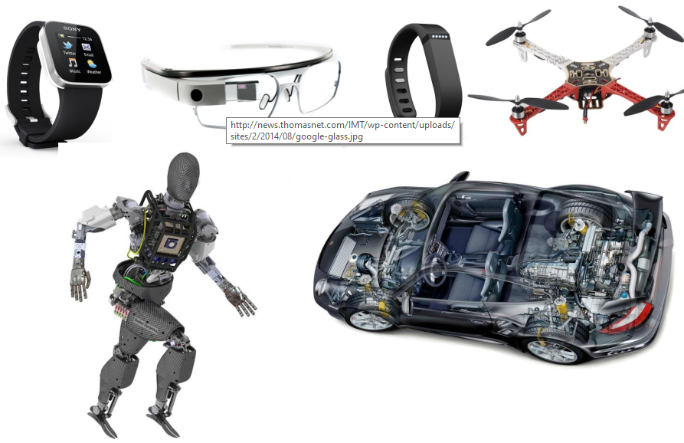
Embedded System

Slide 6
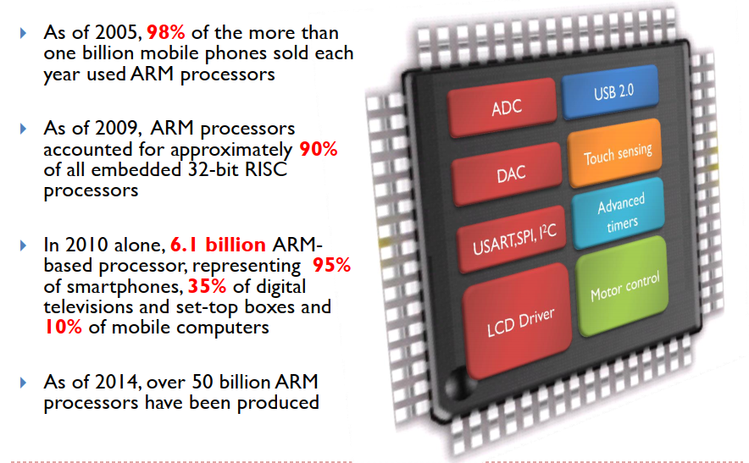
Why ARM Processor

Slide 7
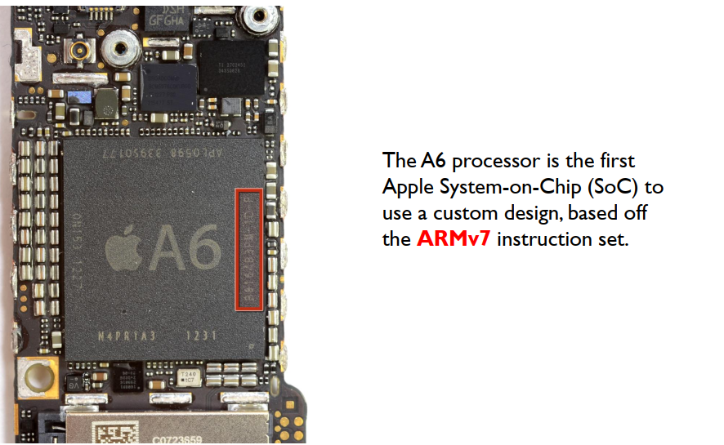

iPhone 5 Teardown

Slide 8
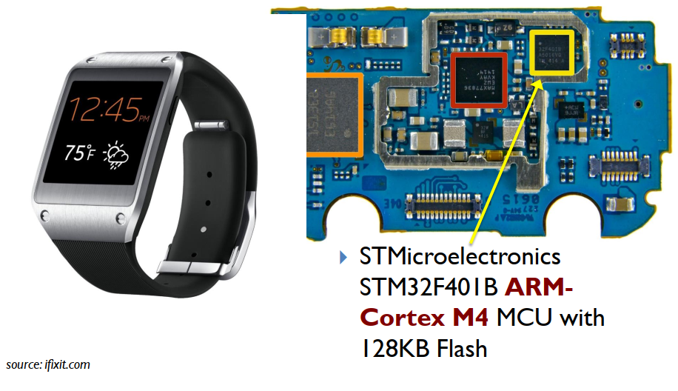
Samsung Galaxy Gear

Slide 9
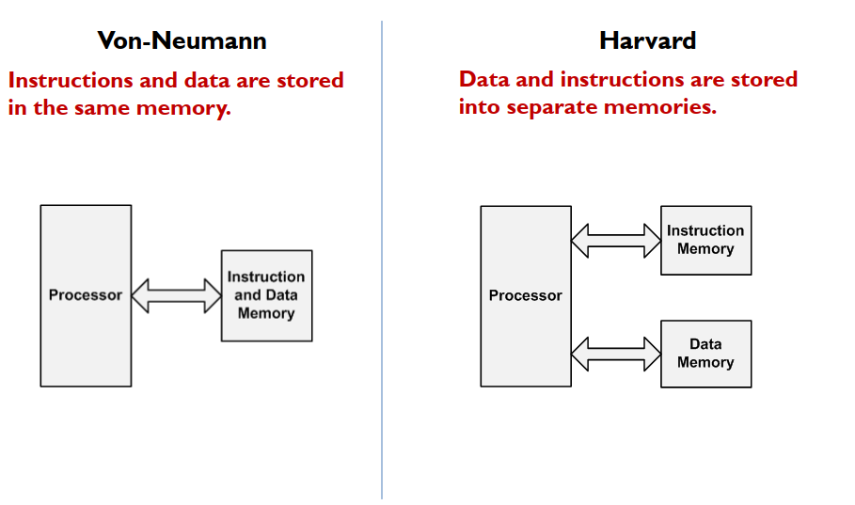
Computer Architecture

Slide 10
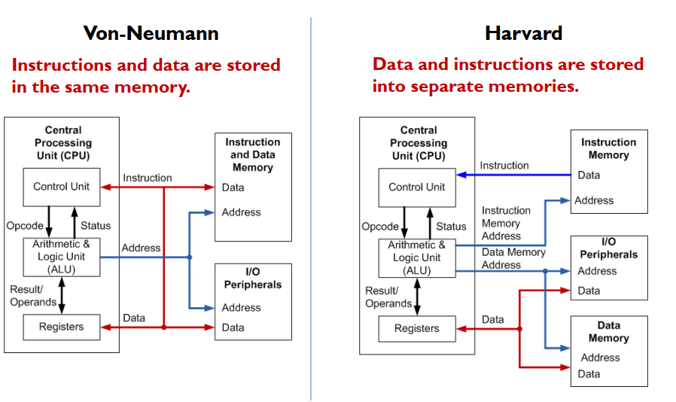
Computer Architecture

Slide 11
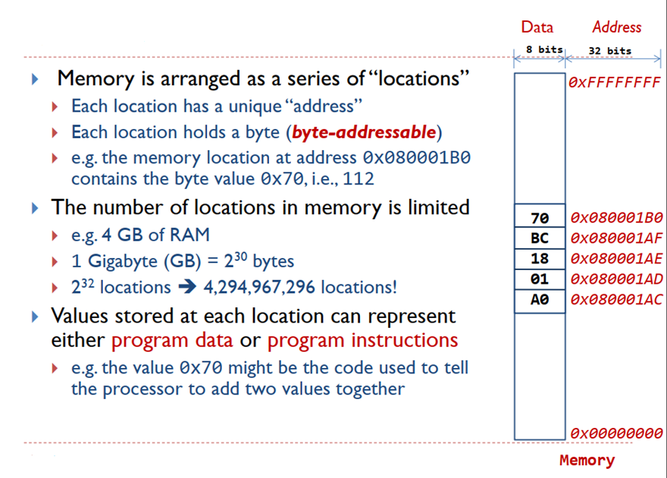
Memory

Slide 12
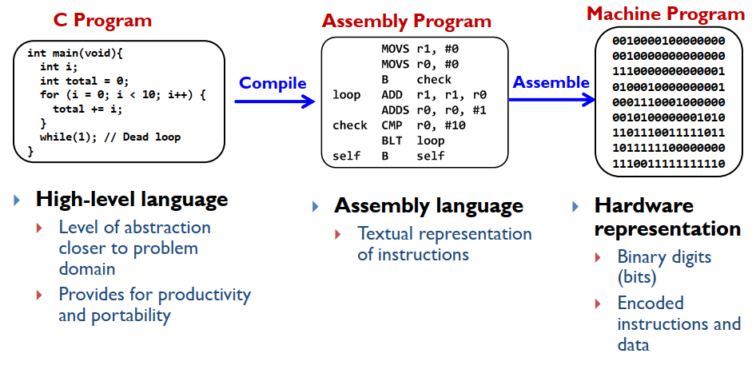
Levels of Program Code

Slide 13
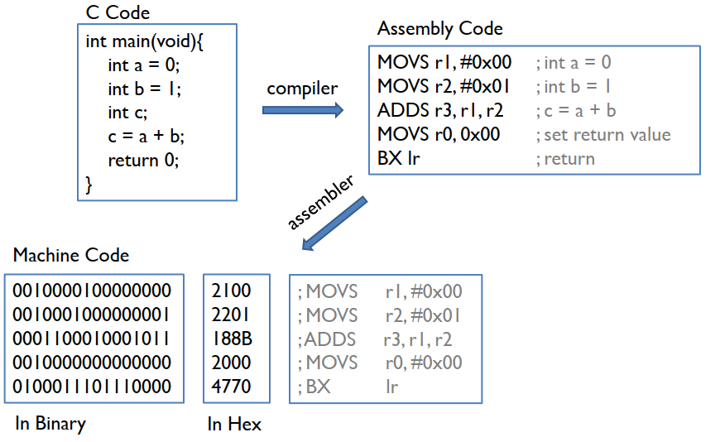
See a Program Runs

Slide 14
Embedded C

Slide 15
Agenda
Logical and Bitwise Operators
Shifting and Inversion
Arrays and Pointers
C Structures
Const qualifier
Symbolic Names

Slide 16
Logical and Bitwise Operators

Slide 17
Logical Operators
A logical operator is used to combine 2 or more conditions in an expression.
Logical AND - &&
  Operator && returns true when both the conditions in consideration are true; else false
Logical OR - ||
  Operator || returns true when either or both the conditions in consideration are true; else false
Logical NOT - !
  Operator ! returns true when either or both the conditions in consideration are true; else false
Logical XOR - !=
  In the Boolean sense, this is just != (not equal)

Slide 18
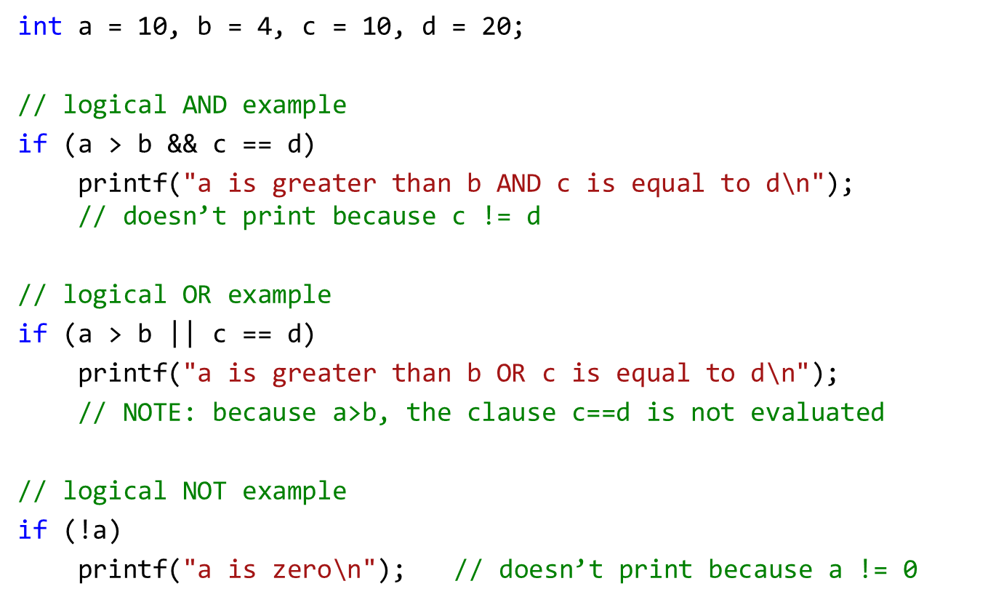
Logical example

Slide 19
C Bitwise Operators
C has 6 operators for performing bitwise operations on integers
Operator | Meaning
& | Bitwise AND | Result is 1 if both bits are 1
| | Bitwise OR | Result is 1 if either bit is 1
^ | Bitwise XOR | Result is 1 if both bits are different
>> | Right shift
<< | Left shift
~ | Ones complement | The logical invert, same as NOT

Slide 20
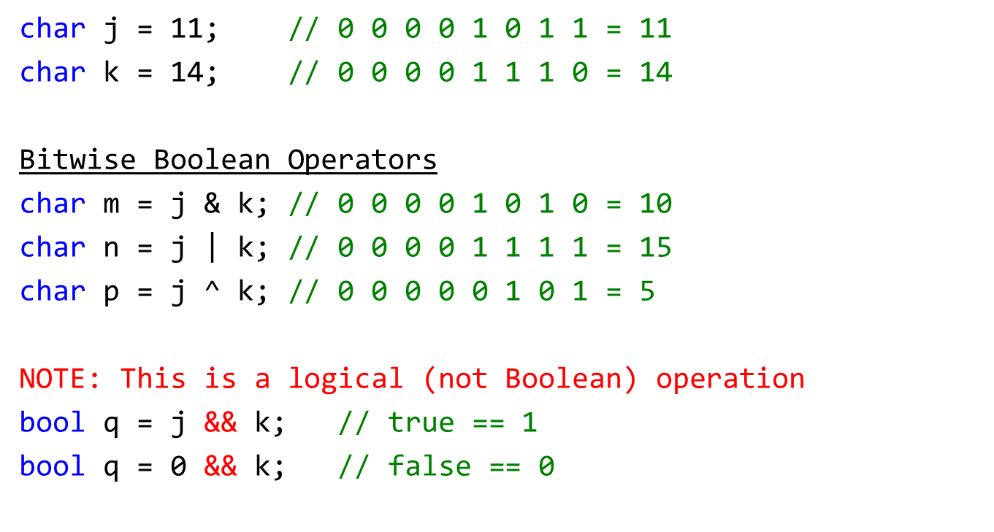
Bitwise Boolean examples

Slide 21
Shifting and Inversion

Slide 22
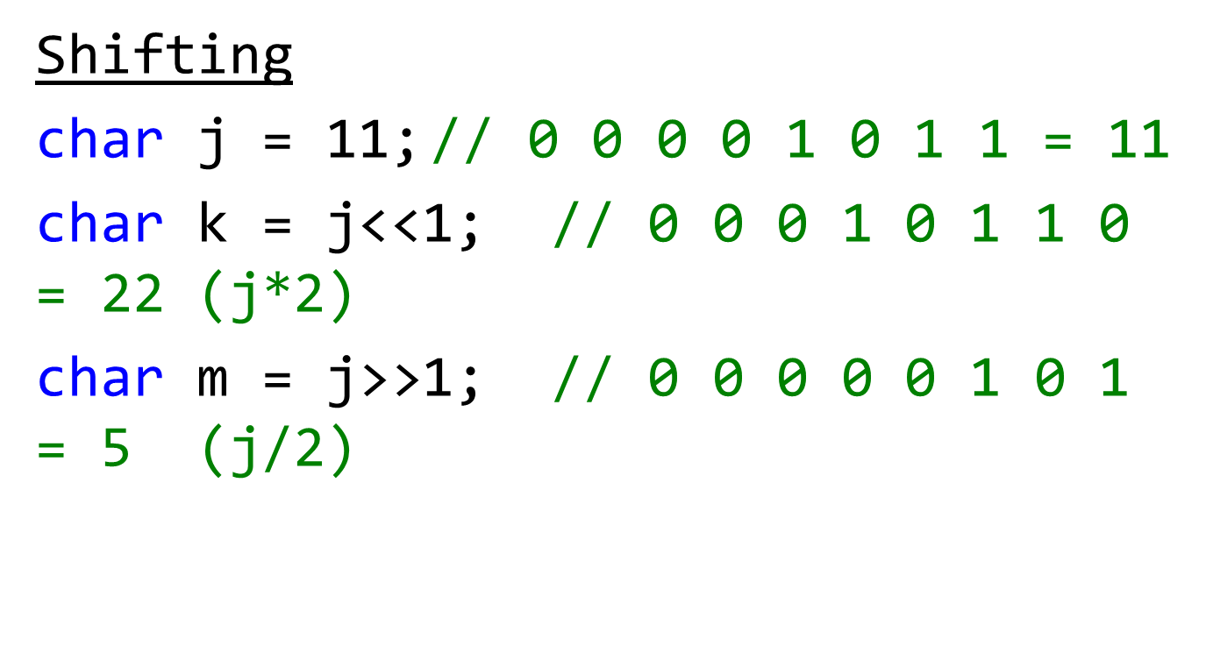
Shifting

Slide 23
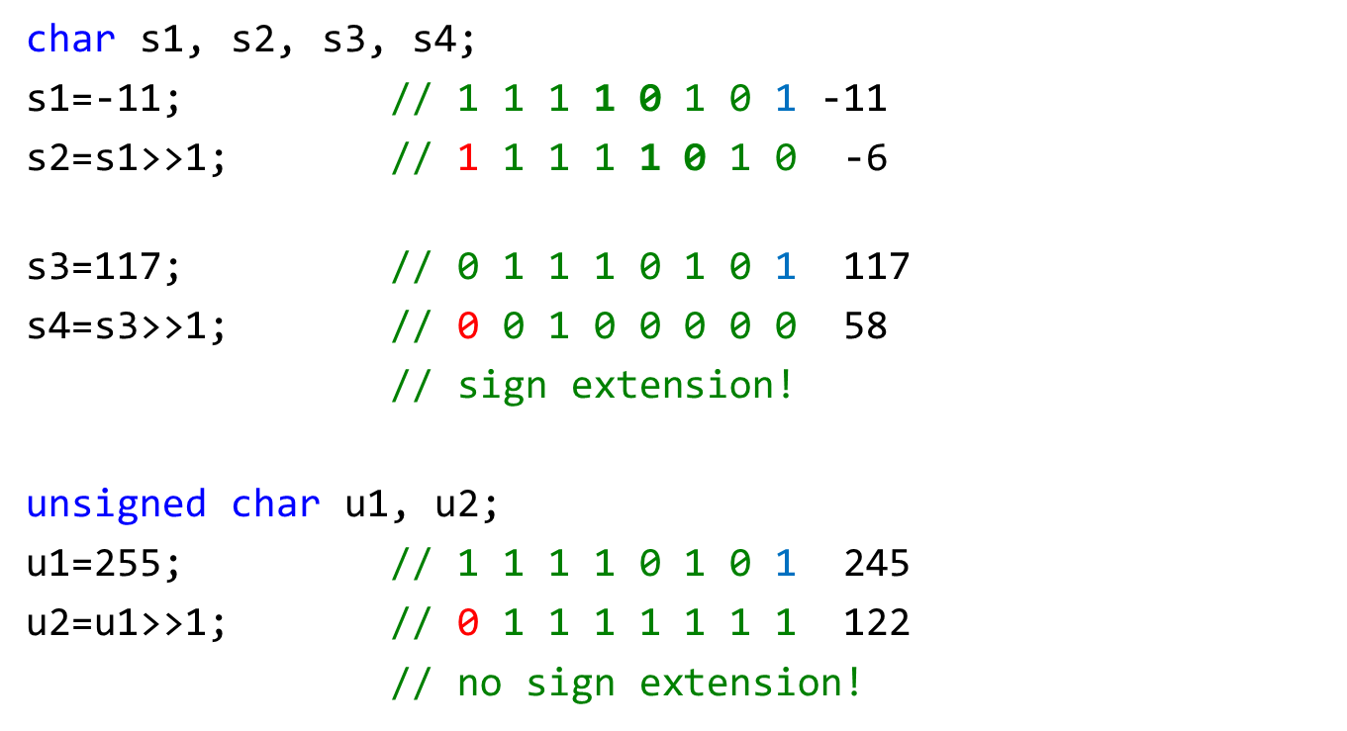
Shifting

Slide 24
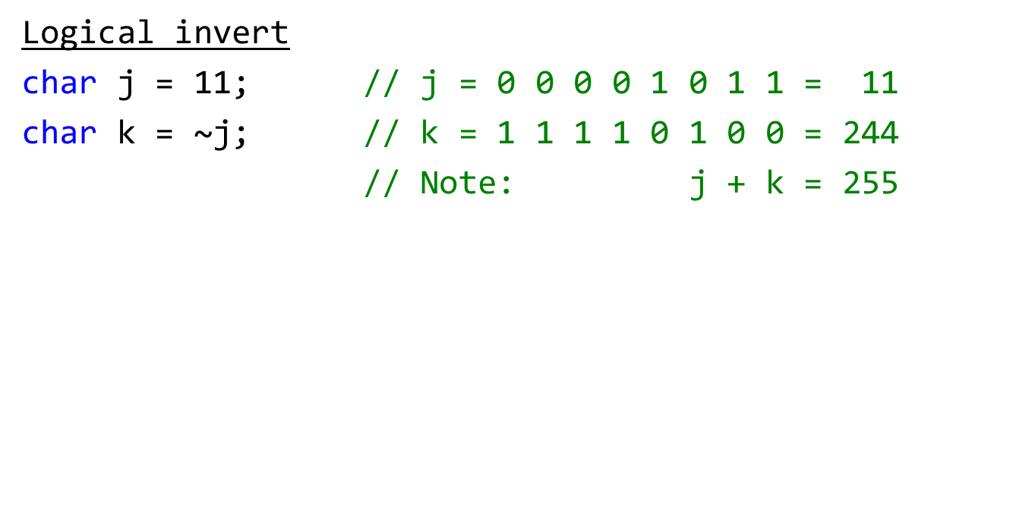
Inversion

Slide 25
Arrays and pointers

Slide 26
Array Identifiers & Pointers
char message_array[] = “Hello” ;
Question: So what exactly is message?
Answer: In C, an array name is a constant pointer that references the 0th element of the array's storage.
Constant means it cannot be changed (just as we can't change the constant 3).

Slide 27
Consequences
char message_array[] = “Hello” ;
char *message = “Hello”;
Question: What is *message?
*message == ‘H’; // an array pointer. It points to the
// start of the array (to 0th element)
Read *message as “what message points to”
What is another expression for message?
message == &message[0]; message[0]==‘H’

Slide 28
Pointer Variables and Arrays
char *hi = “Hello” ;
Allocates space and initializes a constant string “Hello”, then
allocates space for pointer hi and initializes it to point to the 0th element.
char message[] = “Greetings!” ;
Allocates space for the array message and initializes its contents to the string “Greetings!”.
char *p_mesg = message ;
Allocates space for pointer p_mesg and initializes it to point to message.
char ch ; // Declares ch as a char
p_mesg++ ; // Advance p_mesg by one element (char in this case)
ch = *p_mesg ; // Set ch to the character p_mesg points to (in this case 'r').

Slide 29
C Structures

Slide 30
C Structs
A struct is a way of grouping named, heterogeneous data elements that represent a coherent concept.

Slide 31
C Structs
A struct is a way of grouping named, heterogeneous data elements that represent a coherent concept.
Example:
  #define MAXNAME (20)
  struct person {
  char name[MAXNAME+1] ;
  int age ;
  double income ;
  } ;

Slide 32
C Structs
Question: What is an object with no methods and only instance variables public?
Answer: A struct! (well, sort of).
A struct is a way of grouping named, heterogeneous data elements that represent a coherent concept.
Example:
  #define MAXNAME (20)
  struct person {
  int age ;
  double income ;
  } ;
coherent concept -
the information recorded for a person.

Slide 33
C Structs
Question: What is an object with no methods and only instance variables public?
Answer: A struct! (well, sort of).
A struct is a way of grouping named, heterogeneous data elements that represent a coherent concept.
Example:
  #define MAXNAME (20)
  struct person {
  char name[MAXNAME+1];
  int age ;
  double income ;
  } ;

Slide 34
Using Structs
Declaration:
  struct person {
  char name[MAXNAME+1] ; // explicit size known
  char *title; // a pointer has explicit size
  char profession[]; // ILLEGAL, size not known
  int age ;
  double income ;
  } ;
Definitions:
  struct person mike, pete, chris ;
Assignment / field references ('dot' notation):
  mike = pete ; // this does a shallow copy!!
  // If the structure contains pointers, the pointers will be
  // copied, but not what they point to. Thus, after the copy,
  // there will be two pointers pointing to the same memory.
  pete.age = chris.age + 3;

Slide 35
Using Structs
Note: Space allocated for the whole struct at definition.
Struct arguments are passed by value (i.e., copying)
WRONG
void give_raise( struct person p, double pct) {
p.income *= (1 + pct/100) ;
return ;
}
give_raise(mike, 10.0); // what is mike’s income after raise
RIGHT
struct person give_raise(struct person p, double pct) {
p.income *= (1 + pct/100) ;
return p ;
}
mike = give_raise(mike, 10.0) ; // what is mike’s income after raise?

Slide 36
Using Structs pointers
Better if you can pass a pointer to the structure
void give_raise(struct person *p, double pct) {
p->income *= (1 + pct/100) ;
return ;
}
give_raise(&mike, 10.0) ;

Slide 37
Const qualifier

Slide 38
Const qualifier
The const qualifier applied to a declared variable states the value cannot be modified.
Using this feature can help prevent coding errors.
Good for settings and configurations.
const char * - a pointer to a const char
the value being pointed to can't be changed but the pointer can.
char * const - is a constant pointer to a char
the value can be changed, but the pointer can‘t
Order can be confusing…

Slide 39
Const qualifier cont.
To avoid confusion, always append the const qualifier.
int * mutable_pointer_to_mutable_int;
int const * mutable_pointer_to_constant_int;
int * const constant_pointer_to_mutable_int;
int const * const constant_ptr_to_constant_int;

Slide 40
Symbolic Names
typedef

Slide 41
Symbolic Type Names - typedef
Suppose we have a pricing system that prices goods by weight.
  Weight is in pounds, and is a double precision number.
  Price is in dollars, and is a double precision number.
  Goal: Clearly distinguish weight variables from price variables.

Slide 42
Symbolic Type Names - typedef
Suppose we have a pricing system that prices goods by weight.
  Weight is in pounds, and is a double precision number.
  Price is in dollars, and is a double precision number.
  Goal: Clearly distinguish weight variables from price variables.
Typedef to the rescue:
  typedef declaration ;
  Creates a new "type" with the variable slot in the declaration.

Slide 43
Symbolic Type Names - typedef
Suppose we have a pricing system that prices goods by weight.
  Weight is in pounds, and is a double precision number.
  Price is in dollars, and is a double precision number.
  Goal: Clearly distinguish weight variables from price variables.
Typedef to the rescue:
  typedef declaration ;Creates a new "type" with the variable slot in the declaration.
  Examples:
  typedef double PRICE_t; // alias for double to declare price variables
  typedef double WEIGHT_t; // alias for double to declare weight variables
  PRICE_t p ; // double precision value that's a price
  WEIGHT_t lbs ; // double precision value that's a weight

Slide 44
typedef In Practice
Symbolic names for array types
  #define MAXSTR (100)
  typedef char LONG_STRING_t[MAXSTR+1] ;
  LONG_STRING_t line ;
  LONG_STRING_t buffer ;
  LONG_STRING_t *p_long_string;

Slide 45
typedef In Practice
Symbolic names for array types
  #define MAXSTR (100)
  Typedef char LONG_STRING_t [MAXSTR+1] ;
  LONG_STRING_t line ;
  LONG_STRING_t long_string;
Shorter name for struct types:
  typedef struct {
  LONG_STRING_t label ; // name for the point (fixed length)
  double x ; // x-coordinate
  double y ; // y-coordinate
  } POINT_t;
  POINT_t origin ;
  POINT_t focus ;
  POINT_t *p_point = origin;

Slide 46
Question Time

